Slide 1
Game Theory & Network Attacks: How to Destroy Bitcoin

Slide 2
Mining Pools

Slide 3
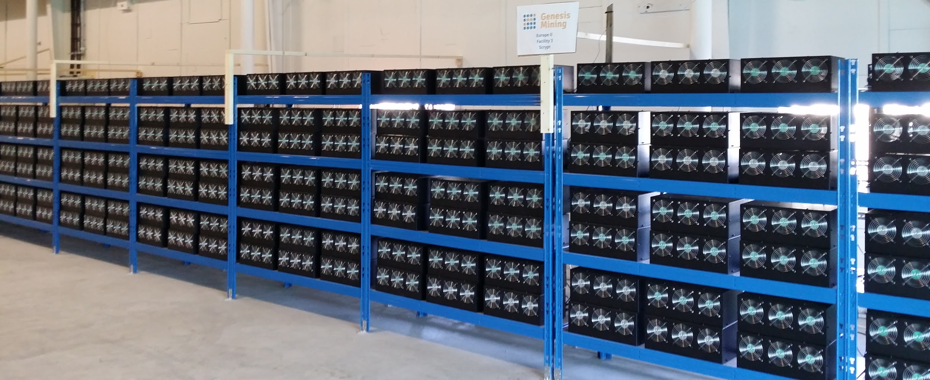
Mining Pools
Mining pools allow individual miners to combine, or 'pool', their computational power together
Reduces variance in mining rewards
Run by pool managers or pool operators
Pool manager usually takes a cut of the mining rewards
Pros
Allows individual miners to participate
Democratizing
Easy to upgrade the network
Pool manager upgrades on behalf of pool participants
Cons
Pool manager must be trusted
Centralized
Enables a whole series of attacks
Notes:
Paradox.
Bitcoin mining is turning electricity into Bitcoin. Electricity costs USD, so it is turning USD into Bitcoin.
Unless Bitcoin mining is subsidized (which it might very well be from the Chinese government), people will only mine if it is profitable to do so.
Efficiency limit to hardware: Hashrate per electricity. Converting units, you get Bitcoin / USD.
Therefore, if the price goes up, then the USD value of the block reward goes up, meaning that there will be more hashpower. But the more hashpower we have the higher the variance on mining reward, and the more we need mining pools, which could collude and attack the Bitcoin network

Slide 4
Mining Pools - Example
Suppose you want to start mining today.
Antminer S9: Costs $2400, 14 TH/s
When do you get your money?
Today's network hashrate: 1,786,321 TH/s
% of network hashrate = (14 TH/s) / (1786321 TH/s) = 0.000783733%
Expected Annual Reward = 5.149 BTC / yr ≈ $3301/yr
Solo mining
1 block mined per 127594 blocks ≈ 12.5 BTC every 881 days ≈ $8059 once every 2 years 5 months
Mining with mining pool (assuming pool has 1/6th of network hashrate):
(5.149 BTC/yr) / [(52560 blocks/yr) / 6] ≈ $0.38 once every hour
Paradox: The more secure Bitcoin gets, the more we need mining pools

Slide 5
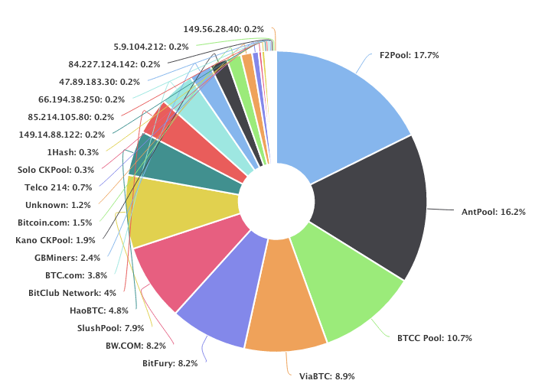
Mining Pool Hashrate Distribution
Community exhibits backlash against large mining pools
Ex: GHash.io in 2014
Single entity might be be participating in multiple pools
Called "Laundering hashes"
Actual concentration of control over mining hardware is unknown
Source: blockchain.info (10/12/16)

Slide 6
Mining Pools - Shares
How to prove that you are contributing to the pool?
Submit Shares: 'Near-valid' blocks
Producing shares implies computational power being expended
Pool operator pays for valid shares
Rewards distributed proportional to # of shares submitted
Valid blocks are shares as well
Individual who finds valid block is not rewarded any extra coins
FAQ: Why can't someone submit shares in a pool and keep the reward of the valid block for themselves?
The valid block is based on the Merkle root given by the pool operator.
Pool public key ➞ Coinbase tx ➞ Merkle Root

Slide 7
Mining Pools - Basic Reward Schemes
Pay-per-share
Pool pays out at every share submitted. By default will be proportional to work done by individuals
More beneficial for miners
Individual miners have no risk from reward variance
Pool takes on the risk completely
Problem: No incentive for individuals to actually submit valid blocks
Individuals are paid regardless
Proportional
Pool pays out when blocks are found, proportional to the work individuals have submitted for this block
More beneficial for the pool
Individual miners still bear some risk in variance proportional to size of the pool
Not a problem if pool is sufficiently large
Lower risk for pool operators - only pay out when reward is found
Individuals thus incentivized to submit valid blocks

Slide 8
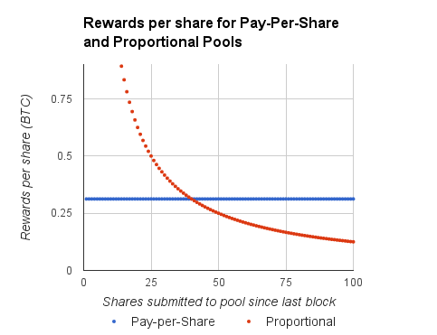
Pool Hopping
Pool hopping: switching between pools to increase total rewards
Proportional pool pays larger amount per share if a block is found quickly
Example clever strategy:
Mine at proportional pool shortly after a block was found (while rewards are high)
Switch to pay-per-share pool when once proportional pool is less profitable
Parameters:
Pool has 10% of network hashrate
4 shares expected per valid block

Slide 9
Pool Hopping
Therefore, proportional pools are not feasible in practice
Honest miners who stay loyal to one pool are cheated out of their money
Designing a mining pool reward scheme with aligned incentives that is not vulnerable to pool hopping remains an open problem
Parameters
Pool has 10% of network hashrate
4 shares expected per valid block

Slide 10
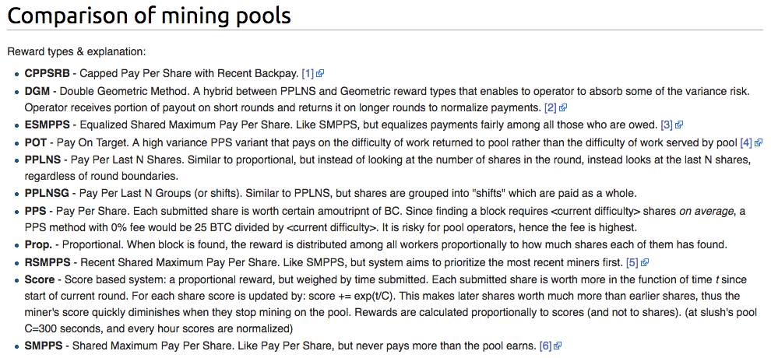
Source: https://en.bitcoin.it/wiki/Comparison_of_mining_pools

Slide 11
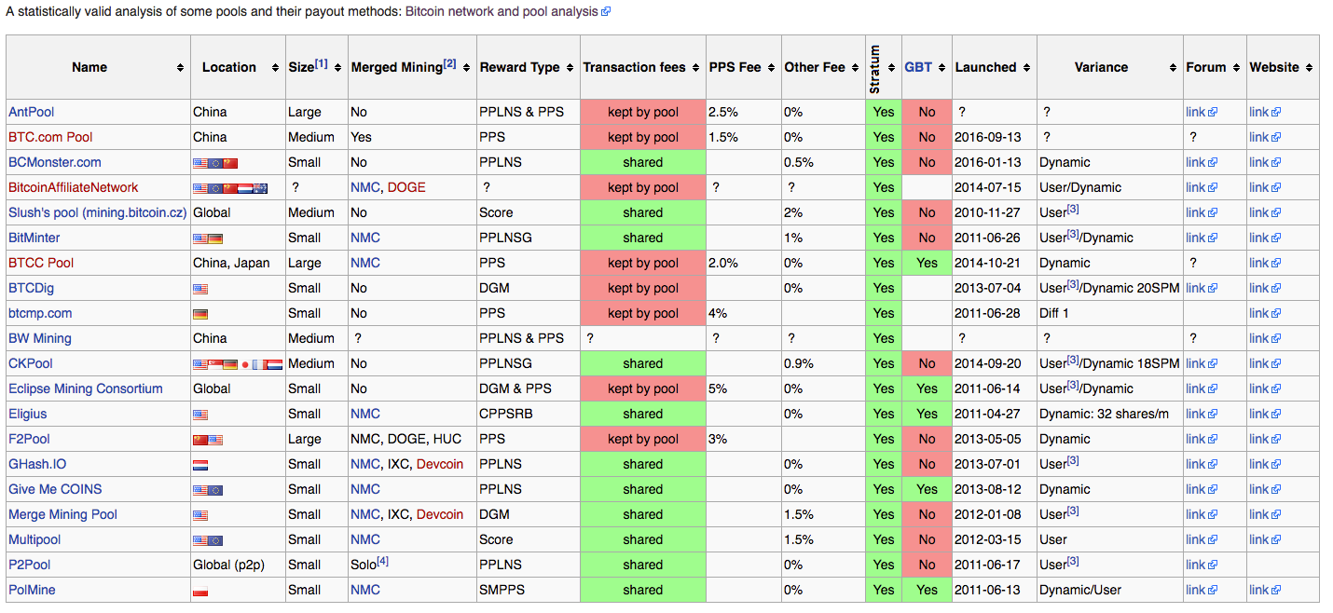
Source: https://en.bitcoin.it/wiki/Comparison_of_mining_pools

Slide 12
Malicious Mining Profit Strategies

Slide 13
Pool Wars
Cannibalizing Pools - Distribute your 1% equally among all other pools, withhold valid blocks.
Rewards will still be received
Undetectable unless statistically significant
Other pool hashrate breakdown:
(70/71 honest, 1/71 dishonest) = 70% honest hashrate = .7 BTC
You own (1/71) of other pools, so expected value of mining there is (1/71) * .7 = 0.0098 BTC
0.0098 (cheat) > 0.0069 (honest)
More profitable to cannibalize pools than mine honestly
You have 30% of the hashrate. Assume 1 BTC block reward. All of the following numbers are expected value.
30% HR (hashrate) = 30% MR (Mining Reward) = 0.3 BTC
You buy more mining equipment, worth 1% of current network hashrate
Standard mining strategy
Add 1% HR => 31/101 = 30.69% HR = .3069 BTC
Revenue gain = 0.0069 BTC for 1% hashrate added
(Originally presented by Martin Koppelmann at SF Bitcoin Devs Seminar)
Notes:
Basic Heuristic: If you have 10% of network hashrate, then you want to additionally cannibalize up to 10% of the hashrate of other pools
Potential solutions:
-Closed pools
-Increase reward for a block significantly compared to a share, defeats the purpose of mining pools

Slide 14
Selfish Mining (Block-Withholding)
You are a miner; suppose you have just found a block.
Instead of announcing block to the network and receiving reward, keep it secret
Try to find two blocks in a row before the network finds the next one
This is called selfish mining or block-withholding
Block not yet found
Note: "block-withholding" is also sometimes used in the context of mining pools - submitting shares but withholding valid blocks
Secret block

Slide 15
Selfish Mining (Block-Withholding)
If you succeed in finding a second block, you have fooled the network
Network still believes it is mining on the longest proof of work chain
You continue to mine on your own chain
Block not yet found
Secret block
Secret block

Slide 16
Selfish Mining (Block-Withholding)
If the network finds a block, you broadcast your two secret blocks and make the network block invalid
While network was working on the invalid block, you got a bunch of time to mine by yourself... for free!
Free time mining on network => higher effective proportion of hashrate => higher expected profits!
New block
Broad cast
Broad cast

Slide 17
Selfish Mining (Block-Withholding)
But what if the network found their new block before you could find a second one? Race to propagate!
If you have 50% chance of winning the race and having your block accepted:
Malicious strategy is more profitable if you have >25% mining power
If you have >33% mining power, you can lose the race every time and malicious strategy is still more profitable!
New block
Broad cast

Slide 18
Double Spend Attack

Slide 19
Double Spend - Example
Double Spend: Successfully spending the same money more than once.
Alice wants to buy an iPhone 0-day exploit from Bob on the black market for $1.5 million ~ 2350 BTC.
How can Alice double spend Bob, i.e., send the money to Bob and receive the goods while simultaneously sending the money to herself?

Slide 20
Double Spend - Confirmations
Confirmations: The number of blocks created on top of the block a txn is in.
= block depth - 1
Block holding my txn
Most recent block
2 confirmations
1 confirmation
0 confirmations

Slide 21
Double Spend - (0)-confirmations Bob
Suppose Bob doesn’t wait for any confirmations on Alice’s transaction. He simply checks that the transaction is valid and immediately sends Alice the exploit.
Bob is vulnerable to a Race Attack!
TX 1
Bob
Rest of the network
Alice → Bob : 2350 BTC
. . .
Included in next block
TX 2
0-day vuln.
Alice → Alice’ : 2350 BTC
TX 2
TX 1
TX 2
Other address controlled by Alice
Alice
Notes:
How to get free coffee ~

Slide 22
Double Spend - (z)-confirmations Bob
Clearly not secure if Bob doesn’t wait for any confirmations… What if Bob waits for z confirmations?
[A → B] transaction needs z confirmations before Bob sends the goods. In order to double spend Bob, Alice needs to mine on her private chain, mine z blocks on top of her block, then broadcast after Bob sends the goods.
Now, Alice has her money back, even though Bob already sent the goods!
Suppose Bob waits for z = 2 confirmations
Honest Network
z = 2 confs, Bob sends goods
A → B
Alice broadcasts her chain, which has a higher block height, so the honest network accepts Alice’s chain over the previous chain.
A → A’
Alice mining blocks, withholding from honest network

Slide 23
Double Spend - Security
Suppose Bob waits for z confirmations before sending the goods.
Alice has h_{A} hash power.
The honest network has h_{H} hash power.
Total network hashpower is then h_{A} + h_{H}.
The probability of the honest network finding the next block:
p = h_{H} / (h_{A} + h_{H}).
The probability of Alice finding the next block:
q = 1 - p = h_{A} / (h_{A} + h_{H}).
The honest network mines z blocks, Bob sends the goods.
In the meantime, Alice has been hard at work mining on her chain. She will have an expected number of blocks mined equal to
λ = z (q / p)
which follows a Poisson Distribution, i.e., the probability that Alice generates k blocks:
p_{A}(k) = (λ^{k} e^{-λ})/(k!)
What is the probability Alice can mine enough blocks in secret to successfully broadcast her chain with the double spend?

Slide 24
Double Spend - Security cont.
First, consider the related problem of Alice trying to catch up to a chain that is j blocks ahead of Alice’s chain.
What is the probability that Alice will ever catch up given an unlimited number of trials? This is while the honest network is simultaneously mining blocks on their chain.
This is an instance of the Gambler’s Ruin problem [1], which has probability
Combining these two probabilities, we can compute the probability that Alice can catch up after z blocks mined on the honest chain.
We do this by considering the probability Alice mines k blocks and then manages to catch up to the honest chain which is z - k blocks ahead, summed over all possible values of k.
Σ∞_{k=0} p_{A}(k) ∙ p_{C}(z - k)
{
1
if k > z
{
1 if q ≥ p OR j < 0
= Σ∞_{k=0} (λ^{k} e^{-λ})/(k!) ∙
(q/p)^{z-k}
if k ≤ z
p_{C}(j) =
(q/p)^{j} if q < p
of Alice catching up if she’s j blocks behind.
[1] Random Walks: Gambler’s Ruin

Slide 25
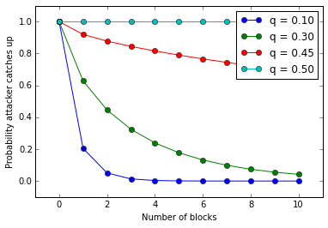
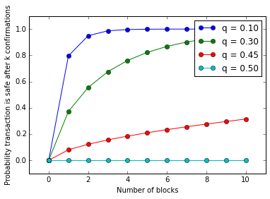
Double Spend - Security cont.
To avoid infinite tail, discrete summation, we look at the inverse probability that Alice can’t catch up to the chain j blocks ahead
= 1 - Σ∞_{k=0} (λ^{k} e^{-λ})/(k!) ∙
= 1 - Σ^{z}_{k=0} (λ^{k} e^{-λ})/(k!) ∙ (1 - (q/p)^{z-k})
So… how many confirmations should Bob wait for, before sending Alice the goods?
Depends on how much hash power we assume Alice to control.
{
0 if k > z
1 - (q/p)^{z-k} if k ≤ z

Slide 26
Double Spend - Bribing Miners
What if Alice controls more than 50% of the total network hash power?
Whenever Alice is j blocks behind the honest network, she will always (in expectation) be able to catch up and out-produce the honest miners.
Therefore, the probability that Alice can successfully double spend with >50% hash power reaches 1!
Bribing Miners:
Alice might not physically control the mining hardware necessary to perform a double spend.
Instead, Alice can bribe miners or even entire pools to mine on her withheld chain.

Slide 27
Double Spending - “Gold Finger” Attack
Why would Alice not want to double spend?
If the rest of the network detects the double spend, it is assumed that confidence in the cryptocurrency and exchange rate would plummet.
If Alice isn’t staked in Bitcoin she can short the currency to profit after her attempted double spend.
What if Alice is a hostile government / adversarial altcoin / large finance institution with significant capital available?
Alice can acquire enough mining ASICs or bribe enough miners / pools to achieve >50% effective hash power.
Alice can perform a so-called “Gold Finger” attack with the objective of destroying the target cryptocurrency, either by destroying confidence in the currency with a double spend or spamming the network with empty blocks.
Ex: Eligius pool kills CoiledCoin altcoin [3]

Slide 28
Blacklisting

Slide 29

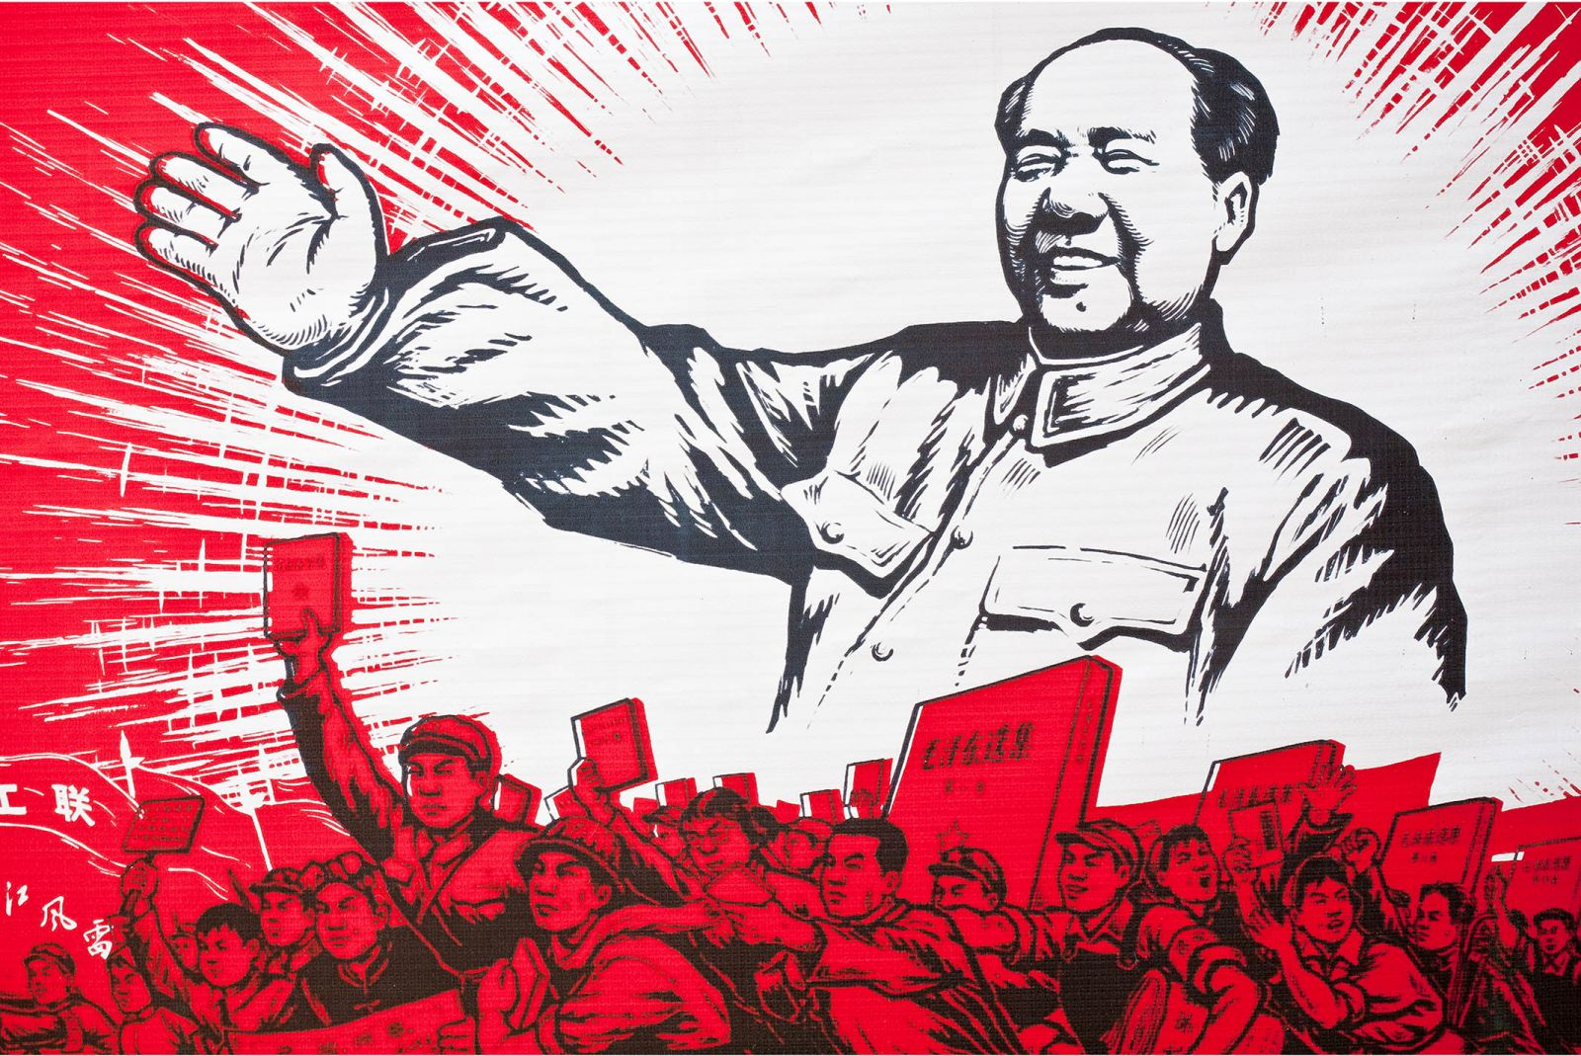
Blacklisting via Punitive Forking
You are a government that has jurisdiction over mining pools, say China.
Objective: Censor the Bitcoin addresses owned by certain people, say Gary Johnson, and prevent them from spending any of their Bitcoin
Block containing transactions from Gary Johnson
Block mined by Chinese miners
Normal block

Slide 30
Blacklisting via Punitive Forking
First strategy:
Tell your country's mining pools not to include Johnson's transactions (blacklisting)
Doesn't work unless you are 100% of the network
Other miners will eventually include Gary Johnson's transactions in a block
Can only cause delays and inconveniences

Slide 31
Blacklisting via Punitive Forking
Second strategy:
Remember, you are China; you have >51% of the network hashrate
Mandate that Chinese pools will refuse to work on a chain containing transactions spending from Gary Johnson's Bitcoin address
Announce this to the world

Slide 32
Blacklisting via Punitive Forking
If non-Chinese miners include a transaction from Johnson in a block, China will fork and create a longer proof of work chain
Block containing Johnson's transaction now invalidated, can never be published

Slide 33
Blacklisting via Punitive Forking
Non-Chinese miners eventually stop trying to include Johnson's transactions when mining blocks, since they know that their block will be invalidated by Chinese miners when they do
We have now shown how a 51% majority can prevent anyone from accessing their funds. This is called punitive forking.

Slide 34
Blacklisting via Feather Forking
Punitive forking doesn't work unless you have >51% of hashpower. Is there another way? Yes! Called Feather Forking
New strategy: Announce that you will attempt to fork if you see a block from Gary Johnson, but you will give up after a while
As opposed to attempting to fork forever; doesn't work without >51%
Ex. Give up after block with Johnson's tx contains k confirmations

Slide 35
Blacklisting via Feather Forking
Let q equal the proportion of mining power you have, 0 < q < 1
Let k = 1: You will give up after 1 confirmation (one additional block)
Chance of successfully orphaning (invalidating) the Johnson block = q²
If q = .2, then q² = 4% chance of orphaning block. Not very good

Slide 36
Blacklisting via Feather Forking
But other miners are now aware that their block has a q² chance of being orphaned. They must now decide whether they should include Johnson's tx in their block
EV(include) = (1 - q²) * BlockReward + Johnson's tx fee
EV(don't include) = BlockReward

Slide 37
Blacklisting via Feather Forking
EV(include) = (1 - q²) * BlockReward + Johnson's tx fee
EV(don't include) = BlockReward
Therefore, unless Gary Johnson pays q² * BlockReward in fees for his transaction, other miners will mine on the malicious chain
4% * 12.5 BTC = 0.5 BTC = Johnson must pay $321 minimum/transaction

Slide 38
Network Attacks

Slide 39
Timejacking
Background: Bitcoin nodes are exchanging monetary transactions over vast distances and time zones; every node needs to be in synch with the other nodes on the network.
Nodes maintain an internal clock time that is computed as the median clock time of its peers.
If the median time differs by more than 70 minutes from the system time, the node reverts its internal clock time to the system time.
As a precaution, nodes reject new blocks with timestamps that are more than 2 hours ahead of its internal clock.
Attack: Attacker launches a sybil attack against the target node and every other node.
For the target node, the attacker aims to set the internal clock 70 minutes behind the wall clock.
For every other node, the attacker wants to set the internal clocks 70 minutes ahead of the wall clock.
[2] Timejacking & Bitcoin

Slide 40
Timejacking cont.
The attacker mines a new block with a timestamp set 190 minutes ahead of the real time.
Every other node accepts the block, since it’s within their 120 minute validation bound.
The target node rejects the block, since it’s past the 120 minute validation bound.
The attacker has now effectively partitioned the network, since the target node thinks every new block is invalid, while the rest of the network continues on.
Assuming the attacker can keep timejacking the target, the attacker has an indefinite amount of time to mine blocks for a double spend attack.
Even with a restricted time window, the attacker still gets several confirmations worth of time to mine on their double spend chain!

Slide 41
DoS Attack - Malicious Miners
Malicious Miners can timejack competing miners, effectively taking the competing miners out of the network and increasing the malicous miner’s effective hash power!
In fact, this works for any denial of service attack (DoS Attack).
Miners with access to a distributed Botnet have a competitive advantage.

Slide 42
Transaction Malleability
When is this an issue? In some cases, transactions rely on a chain of previous transactions (common in micro payments / lightning network).
Changing the hash image of a prior transaction in the chain will invalidate every subsequent transaction!
Example: Mt. Gox Incident. Mt. Gox claims attacker made withdrawals, then used txn malleability to change txid in-flight. To Mt. Gox, it looks like the txn didn’t go through. Meanwhile, the BTC was actually sent!
Solutions? The new SegWit (Segregated Witness) proposal stores transaction signatures in a separate merkle tree, effectively fixing transaction malleability. Not yet in production
Nodes relaying a fresh transaction can tweak certain fields to make a version of the transaction with a different hash image, and the digital signature still verifies!
For example, in ECDSA, the signature pair (r, s) is equivalent to the signature pair (r, -s (mod N)).
Both validate the same transaction data, but now the hash image changes.
Additionally, the scriptSig field can (sometimes) have extraneous script ops tacked on the end.

Slide 43
Next Time: Ethereum
Ethereum White paper too casual or hand-wavy for you? Try the Ethereum Yellow Paper instead. For brave souls only.
Benedict Chan, Lead Platform Engineer of BitGo is speaking on Ethereum security (10/17)
Free pizza / refreshments
356 Barrows at 7pm, Mon Oct 17
https://www.meetup.com/Berkeley-Bitcoin-Meetup/events/234585426/
Blockchain @ Berkeley Infosession (10/24)
356 Barrows at 7pm, Mon Oct 24
Application information
https://www.facebook.com/events/385771441768358/
Readings
The Ethereum White Paper - accessible overview of Ethereum
https://github.com/ethereum/wiki/wiki/White-Paper
"Ethereum" section
All subsections
"Miscellanea And Concerns" section
Selected subsections: "Fees", "Computation And Turing-Completeness"
"Conclusion"
Optional reading (there will be a bonus question on this)
"Scripting" subsection
Remaining subsections in "Miscellanea And Concerns"

Slide 44
Lemmas 1 & 2
(Originally presented by Martin Koppelmann at SF Bitcoin Devs Seminar)
Computational power requires electricity requires $$, reaches equilibrium if miners are breaking even or profitable
Lemma 1: Mining Reward = Mining Cost
If you are roughly breaking even with the capital you invest, there is little to no marginal cost to getting more hashrate. You simply need more capital to attain 51%
Lemma 2: Cost of acquiring 51% < Mining cost

Slide 45
Lemma 3
(Originally presented by Martin Koppelmann at SF Bitcoin Devs Seminar)
What profits can you get from owning >51% of the hashrate
Crash the currency? No problem. Regain value (and then some) by shorting Bitcoin on an exchange
You can effectively get 100% of the mining reward
Only mine on your own blocks
Can prevent anyone else from mining - you always produce longest PoW chain
How this would affect the price depends on threshold
q = 51% => 49% of blocks are orphaned (eh)
q = 80% => 20% of blocks are orphaned
Average Bitcoin user not really affected, still able to make transactions
Lemma 3: Value of 51% attack > Mining Reward

Slide 46
Combining Lemmas
Lemmas:
Lemma 1: Mining Reward = Mining Cost
Lemma 2: Cost of acquiring 51% < Mining Cost
Lemma 3: Value of 51% attack > Mining Reward
Therefore, Value of 51% attack > Cost of acquiring 51%
If math is correct, Game Theory says that 51% attacking Bitcoin is profitable
(Originally presented by Martin Koppelmann at SF Bitcoin Devs Seminar)

Slide 47
Additional Ideas
(Originally presented by Martin Koppelmann at SF Bitcoin Devs Seminar)
A way to offset costs incurred by mining pools
More orphaned blocks are a sign of pool wars
Insurance contracts for bitcoin stakeholders based on number of orphaned blocks

Slide 48
Generalization of Vulnerabilities
Bitcoin mining is zero sum
In general, to increase earnings, someone else needs to be excluded
Members-only Mining
Let hashrate join a collusion until 80% of the network is in, then exclude the rest
No incentive not to join
Attack succeeds, get increased reward
Attack wouldn't fail: conduct attack in such a way that it wouldn't start until the threshold is reached
Naive Example
3 pools collude, own more than 51%
Ignore every 10th block of another pool
Undetectable
More profitable than honest strategy

Slide 49
Post-block Reward Bitcoin
Assumption: average Bitcoin user holds $100,000 in Bitcoin, willing to pay $1000 in fees
(This is when Bitcoin is near 0 block reward)
Is mining based off transaction fees sustainable?
Money must move, must be paid in transaction fees so that miners can collect it as mining reward
Amount of hashpower going into Bitcoin dependent on mining reward
Therefore
(average fees paid) / (avg holdings) = (cost of attacking) / (market cap)
In our example, attacker only needs to pay 1% of the market cap of Bitcoin to attack
Post reward Bitcoin must have a high velocity of money to be secure

Slide 50
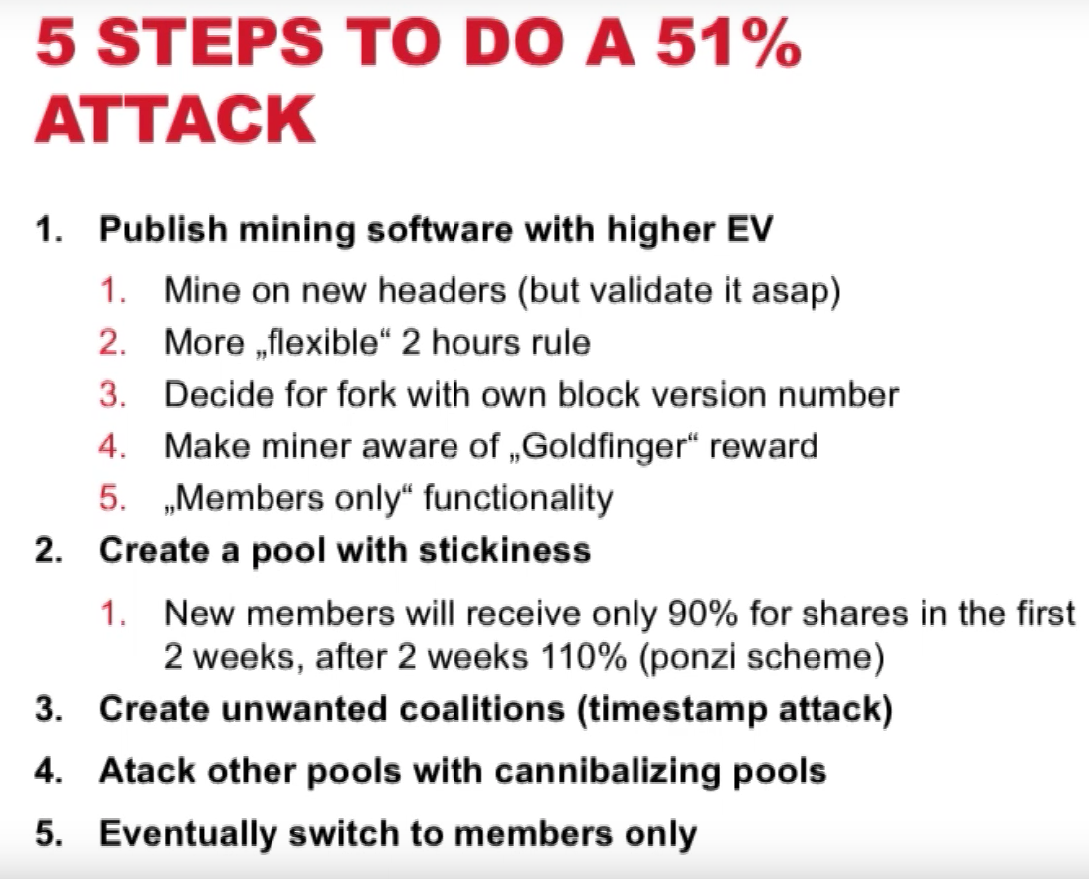
Conclusions
Use something better than QT
This works
If you reach 51%, you get a higher reward, so it's sustainable
Hashrate / PoW does not secure Bitcoin/transactions - full nodes do! PoW only distributes votes
Other mechanics for vote distribution are maybe fine

